Slide 1
Winter 25-26 PS -Robotic Sensing and Knowledge Transfer Learning in Safety-Critical Environments 2 – Introduction to Reinforcement Learning Model-Free Methods
Prof. Dr. Holger Giese (Holger.Giese@hpi.de)
Christian Medeiros Adriano (Christian.Adriano@hpi.de) - “Chris”
Dr. Sona Ghahremani (Sona.Ghahremani@hpi.de)
Finn Kaiser (Finn.Kaiser@hpi.de)
He Xu (He.Xu@hpi.de)
Mustafa Ghani (Mustafa.Ghani@hpi.de)

Slide 2
The Problem of Reinforcement Learning
Learn to Make Decisions by Interacting with an Environment

Slide 3
Multi-Armed Bandits
"When solving a problem of interest, do not solve a more general problem as an intermediate step“
Vladimir Vapnik [1]
Notes:
https://en.wikipedia.org/wiki/Transduction_(machine_learning)
https://stats.stackexchange.com/questions/568821/is-there-a-good-illustrative-example-where-the-hinge-loss-svm-gives-a-higher-a
Vapnik wrote this in the context of transductive learning, but the principle could also be applied to statistical pattern recognition tasks. If we just need to perform a hard classification, then we should aim to determine the decision boundary directly, rather than estimating the posterior probability of class membership and then threshold that at 0.5 (or some other threshold depending on the misclassification costs).
In principle, we may be able to get better generalisation in terms of accuracy by following this principle as it focusses on the needs of the application, and avoids modelling compromises that benefit modelling of aspects of the data that are not relevant to the application at the expense of other aspects that are.

Slide 4
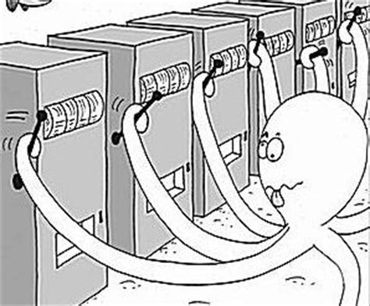
Why Multi-Armed Bandits (MAB)?
MAB allows to learn while making sequential decisions
Algorithms are simple, elegant and with rigorous theoretical guarantees of performance
Many applications in practice!
Clinical trials [1,2,3,4]
Pricing [5], Innovation [6], Auctions [7]
Assortment/Recommendations [8]
Adversting planning [9,10]
A/B testing [11], Load balancing [12], Routing [13]
Notes:
[1] W. R. Thompson. On the likelihood that one unknown probability exceeds another in view of the evidence of two samples. Biometrika, 25:285–294, 1933.
[2] H. Robbins. Some aspects of the sequential design of experiments. Bulletin of the American Mathematical Society, 55:527–535, 1952.
[3] M. Zelen. Play the winner rule and the controlled clinical trials. Journal of the American Statistical Association, 64:131–146, 1969.
[4] Aziz et al., 2019, "On Multi-Armed Bandit Designs for Phase I Clinical Trials", https://www.groundai.com/project/on-multi-armed-bandit-designs-for-phase-i-clinical-trials/1
[5] D. Bergemann and J. Valimaki. Learning and strategic pricing. Econometrica, 64:1125–1149, 1996.
[6] D. Bergemann and U. Hege. The financing of innovation: Learning and stopping. RAND Journal of Economics, 36 (4):719–752, 2005.
[7] R. D. Kleinberg and T. Leighton. The value of knowing a demand curve: Bounds on regret for online posted-price auctions. In Proceedings of the 44th Annual IEEE Symposium on Foundations of Computer Science (FOCS), pages 594–605, 2003.
[8] F. Caro and G. Gallien. Dynamic assortment with demand learning for seasonal consumer goods. Management Science, 53:276–292, 2007.
[9] S. Pandey, D. Agarwal, D. Charkrabarti, and V. Josifovski. Bandits for taxonomies: A model-based approach. In SIAM International Conference on Data Mining, 2007.
[10] Lu, T., Pál, D., & Pál, M. (2009). Showing relevant ads via context multi-armed bandits. In Proceedings of AISTATS.
[11] Microsoft Research, 2017, "Contextual bandit breakthrough enables deeper personalization", https://www.microsoft.com/en-us/research/blog/contextual-bandit-breakthrough-enables-deeper-personalization/
[12] B. Awerbuch and R. D. Kleinberg. Adaptive routing with end-to-end feedback: distributed learning and geometric approaches. In Proceedings of the 36th ACM Symposium on Theory of Computing (STOC), pages 45–53, 2004.
[13] Carrascosa, M., & Bellalta, B. (2019). Decentralized AP selection using Multi-Armed Bandits: Opportunistic {\epsilon}-Greedy with Stickiness. arXiv preprint arXiv:1903.00281.

Slide 5
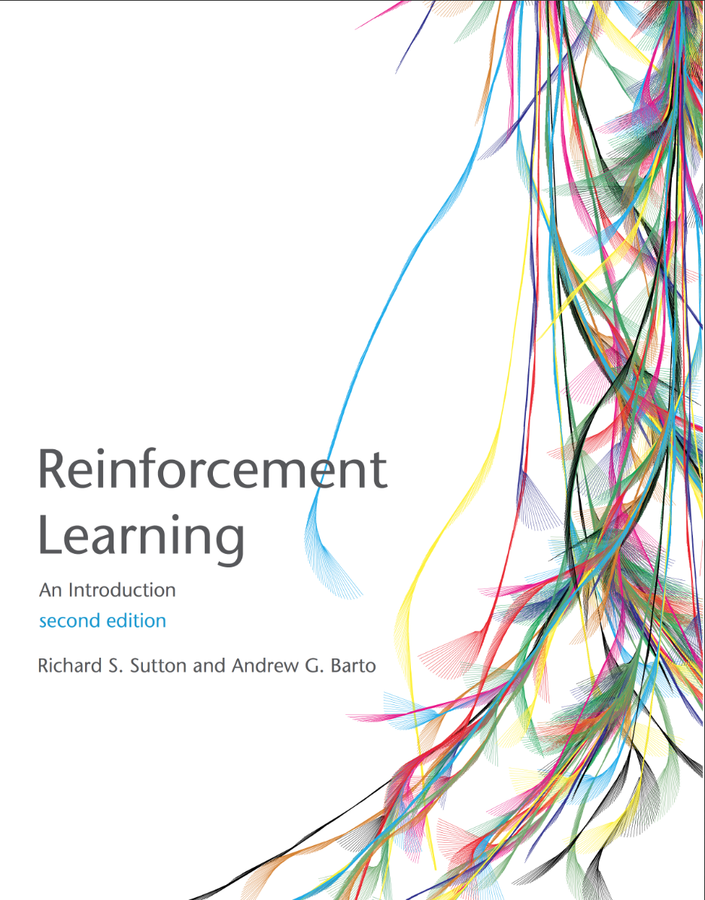


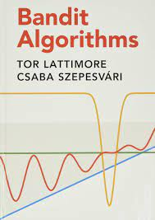
Textbooks (free access)
Sutton, R. S., & Barto, A. G. (2015). Reinforcement learning: An introduction. MIT press. http://richsutton.com
Aleksandrs Slivkins (2019). Introduction to Multi-Armed Bandits, Foundations and Trends® in Machine Learning: Vol. 12: No. 1-2, pp 1-286. https://arxiv.org/abs/1904.07272
Daniel J. Russo, Benjamin Van Roy, Abbas Kazerouni, Ian Osband and Zheng Wen (2017). A Tutorial on Thompson Sampling https://web.stanford.edu/~bvr/pubs/TS_Tutorial.pdf
Tor Lattimore and Csaba Szepesvári, (2020). Bandit Algorithms, https://tor-lattimore.com/downloads/book/book.pdf
Notes:
https://www.microsoft.com/en-us/research/blog/exploring-the-fundamentals-of-multi-armed-bandits/

Slide 6
Definition
The multi-armed bandit (MAB) problem consists of an agent (gambler) choice at each round
of play one of K arms. Each arm has an unknown reward distribution.
Rewards are only obtained (observed) when the arm is chosen. The goal of the agent is to maximize the cumulative expected rewards over a time horizon (T).
The agent strategies consists of balancing the cost of acquiring knowledge about the arms (exploration) and maximizing the immediate rewards (exploitation).
The trade-off between exploration and exploitation implies a cost is called regret (L), which the agent wants to minimize over the time horizon T.

Slide 7
Topics
Exploration vs Exploitation
Regret
Strategies
ε-Greedy
Upper-confidence bounds (UCB)
Bayesian Thompson sampling
Contextual Bandits

Slide 8
Model
State = only one
Actions = number of arms
Reward = often normalized to be in [0,1]
Implications?
No transitions function to be learned
Only thing left to learn is the stochastic reward function

Slide 9
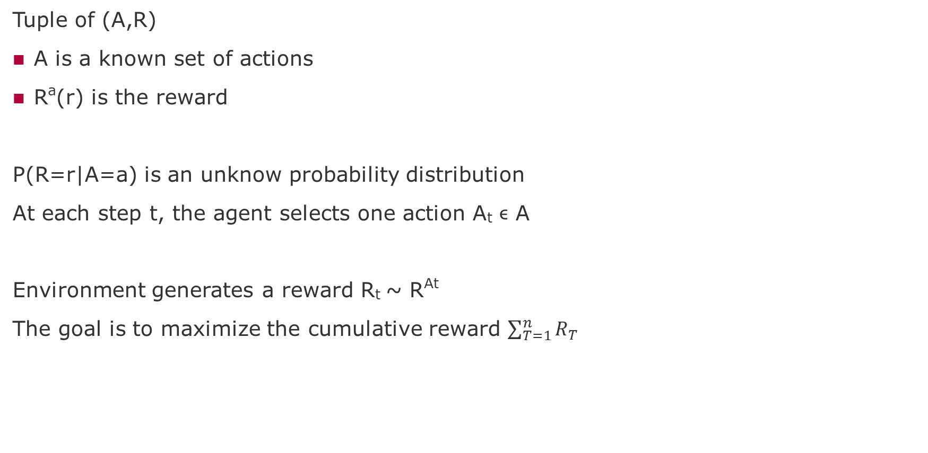
Problem Formalization
Tuple of (A,R)
A is a known set of actions
Rª(r) is the reward
P(R=r|A=a) is an unknow probability distribution
At each step t, the agent selects one action A_{t} ϵ A
Environment generates a reward R_{t} ~ R^{At}
The goal is to maximize the cumulative reward $\sum_{T=1}^{n}{R_{T}}$

Slide 10
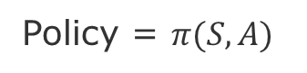
Agent and Environment Interaction
Action
Agent
Environment
State
Reward
Agent’s Goal: Maximize its reward
Our Goal: Discover a strategy that allows the agent to achieve its goal under various circumstances
Search, Estimate, Learn
Policy = $π(S,A)$
knowlege about the environment

Slide 11
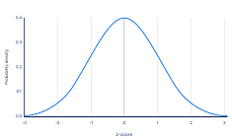
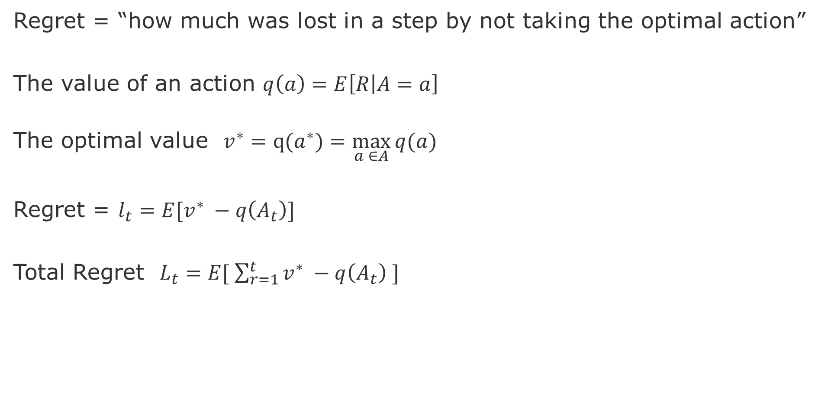
Solution Formalization - Regret
Regret = “how much was lost in a step by not taking the optimal action”
The value of an action $q\left(a\right)=E\left[R | A=a\right]$
The optimal value $v^{∗}=q(a^{∗})=\max_{a ∈A}{q(a)}$
Regret = $l_{t}=E[v^{∗} −q\left(A_{t}\right)]$
Total Regret $L_{t}=E[ \sum_{r=1}^{t}{v^{∗} −q\left(A_{t}\right) ]}$
Goal: Minimize this

Slide 12
Approaches to Trade-off Explore vs Exploit
Random
Greedy (no exploration)
ϵ-Greedy (epsilon Greedy)
Systematically
Upper Confidence Bounds
Thompson Sampling
Contextual Bandits
State Space
Bayes Adaptive Bandits
Gittin indices Bandits

Slide 13
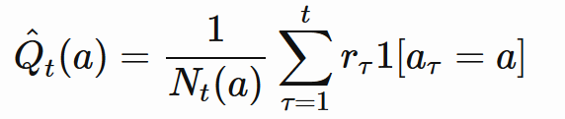
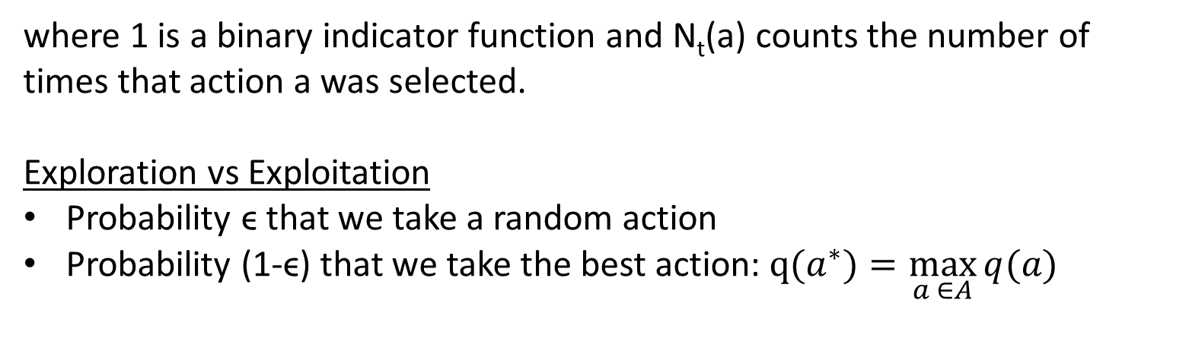
ϵ-Greedy
Total reward of an action is Monte Carlo estimate of rewards obtain for that action
where 1 is a binary indicator function and N_{t}(a) counts the number of times that action a was selected.
Exploration vs Exploitation
Probability ϵ that we take a random action
Probability (1-ϵ) that we take the best action: $q(a^{∗})=\max_{a ∈A}{q(a)}$

Slide 14
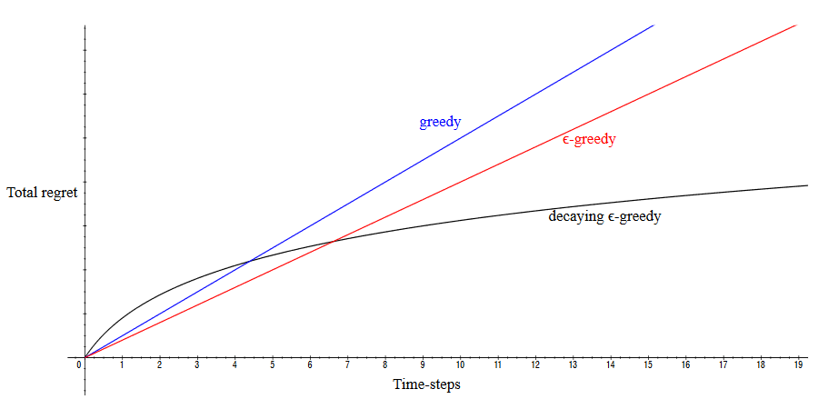
Decaying ϵ-Greedy
Follows a decay series ϵ_{1,}ϵ_{2,}ϵ_{3 ...} ϵ_{n}
Source: [Silver 2015]
Notes:
[Silver 2015] https://www.davidsilver.uk/wp-content/uploads/2020/03/XX.pdf

Slide 15
Systematic Exploration

Slide 16

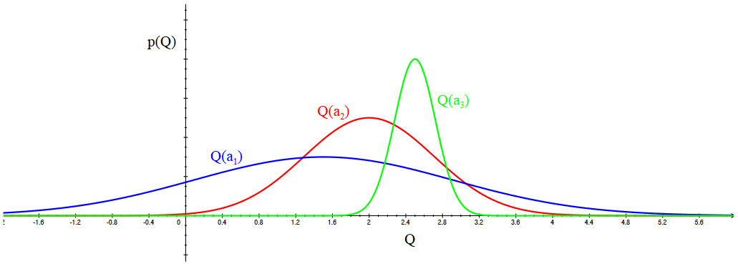
Optimism in face of uncertainty
No catastrophic consequence of our decisions.
We either learn something new or obtain a maximum reward
(what doesn’t kill you makes you stronger...)
Source: Silver, https://www.davidsilver.uk/wp-content/uploads/2020/03/XX.pdf
Notes:
[Silver 2015] https://www.davidsilver.uk/wp-content/uploads/2020/03/XX.pdf

Slide 17
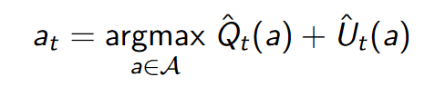
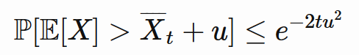
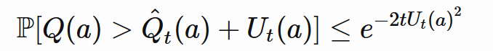
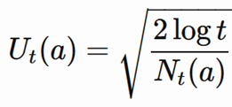
Upper Confidence Bounds
Select action that maximizes the action value with a given upper confidence bound
Hoeffdings Inequality

Slide 18
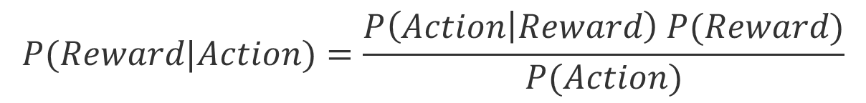
Bayesian Bandits
Bayesian bandits exploit prior knowledge of rewards P(R).
Uses Bayesian Rule to update the probabilities of reward of each action.
___
$$P(Reward|Action)=\frac{P\left(Action | Reward\right) P(Reward)}{P(Action)}$$
Bayesian Bandits depend on good knowledge about the prior distribution of rewards. When this is true, the search process for the best arm is more efficient, i.e., less useless exploration.

Slide 19
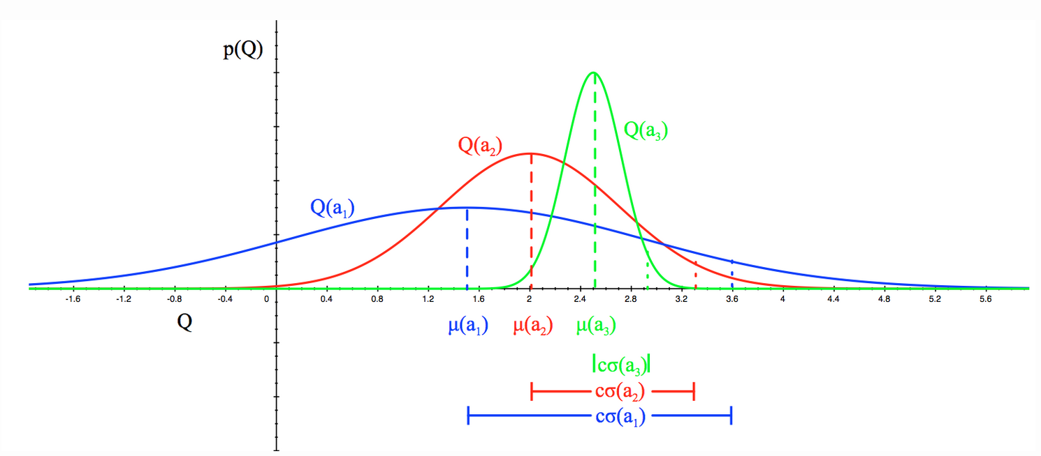
Bayesian Bandits Algorithm
The posterior probability can be used by the following algorithms:
Upper confidence bounds (Bayesian UCB)
Probability matching (Thompson sampling)
Source: Silver, https://www.davidsilver.uk/wp-content/uploads/2020/03/XX.pdf

Slide 20
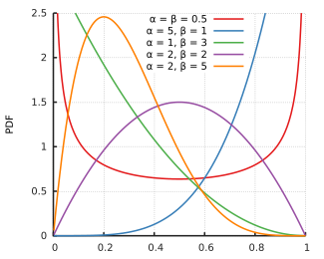
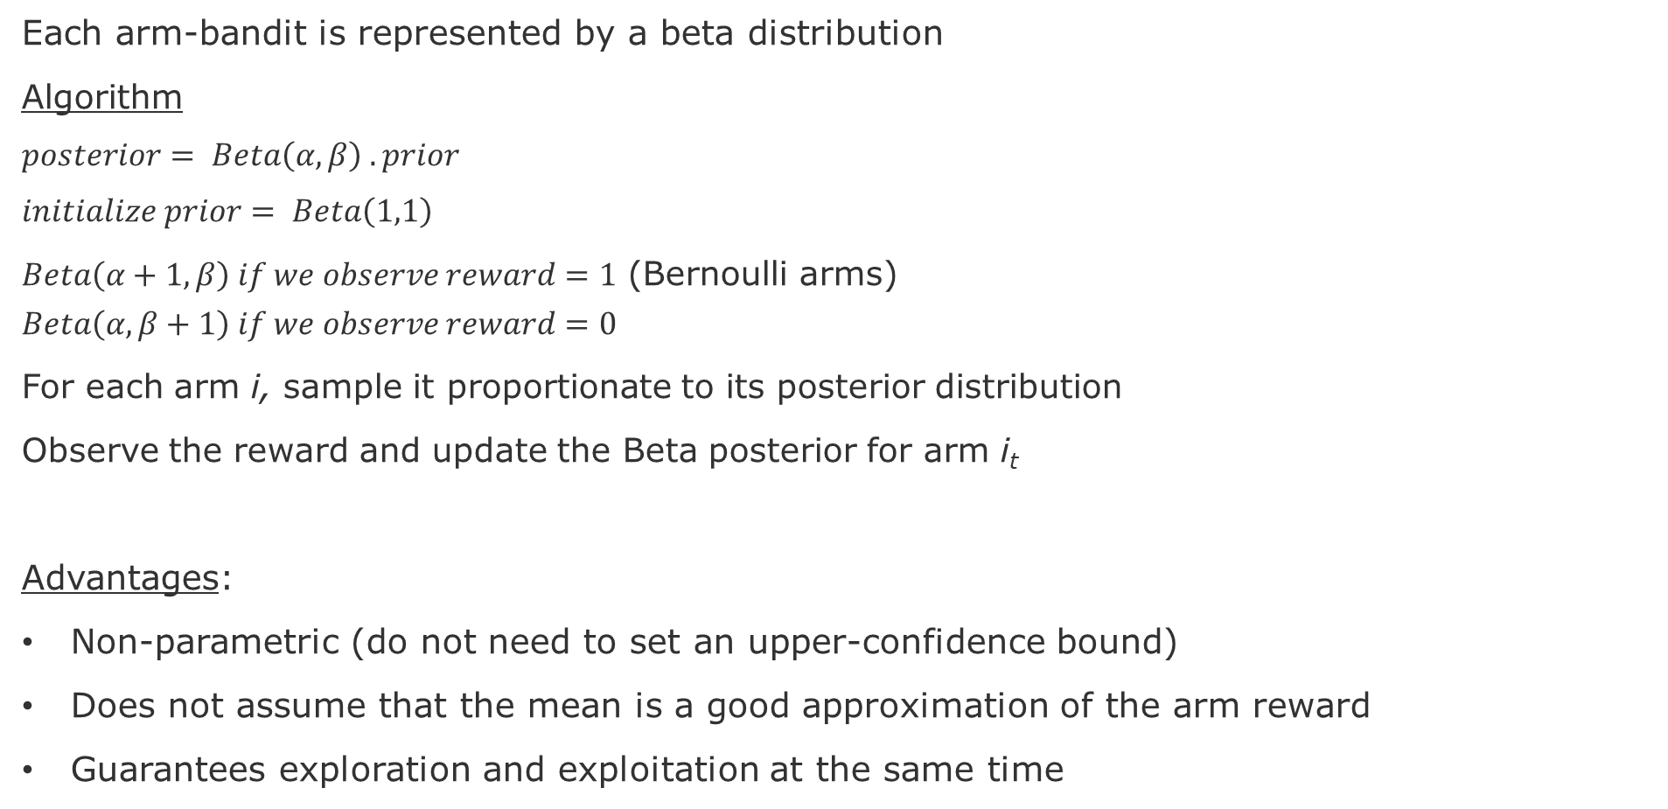
Bayesian Bandits – Thompson Sampling
Each arm-bandit is represented by a beta distribution
Algorithm
$$posterior= Beta\left(α,β\right) . prior$$
$$initialize prior= Beta\left(1,1\right)$$
$Beta\left(α+1,β\right) if we observe reward=1$ (Bernoulli arms) $$Beta\left(α,β+1\right) if we observe reward=0$$
For each arm i, sample it proportionate to its posterior distribution
Observe the reward and update the Beta posterior for arm i_{t}
Advantages:
Non-parametric (do not need to set an upper-confidence bound)
Does not assume that the mean is a good approximation of the arm reward
Guarantees exploration and exploitation at the same time
source: Wikipedia

Slide 21
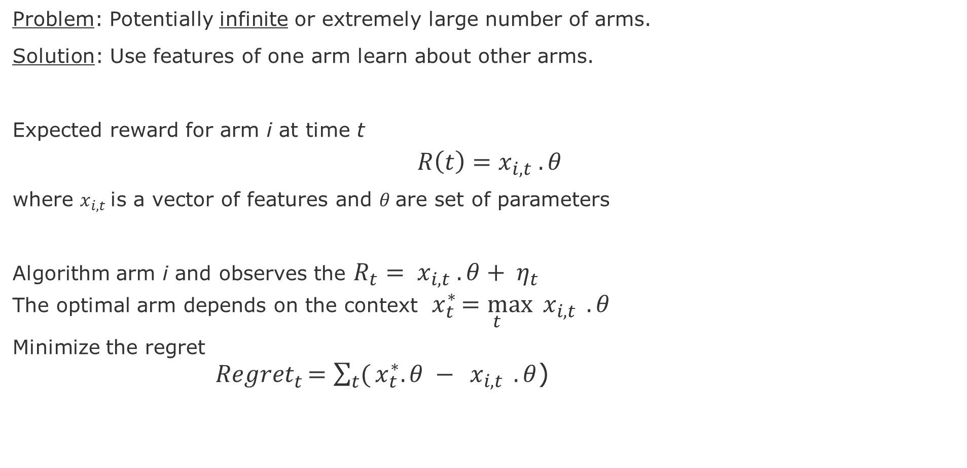
Contextual Bandits
Problem: Potentially infinite or extremely large number of arms.
Solution: Use features of one arm learn about other arms.
Expected reward for arm i at time t
$$R\left(t\right)=x_{i,t} .θ$$
where $x_{i,t}$is a vector of features and $θ$are set of parameters
Algorithm arm i and observes the $R_{t}{= x}_{i,t} .θ+ η_{t}$
The optimal arm depends on the context $x_{t}^{∗}\underset{t}{=max}{{ x}_{i,t}} .θ$
Minimize the regret
${Regret}_{t}^{ }\underset{ }{=\sum_{t}{(}x_{t}^{∗}.θ −}{{ x}_{i,t}} .θ$)

Slide 22
Other Bandit Models
Adversarial Bandits: do not assume that rewards have a distribution (see [1-2])
Combinatorial bandits: special case of Linear Bandits where the actions are multi-dimensional (see [3-4]). See ideas for ranking with bandits in [5].
Markovian bandits: reward processes are neither i.i.d. nor adversarial. Arms are Markov processes with their own state space (see [6-7])
Infinitely many-armed bandits: continuum-armed bandits (arms are in a Euclidean space), which means that the set of possible actions are very large (see [8-9])
Notes:
[1] Chapter 27 in Lattimore, T., & Szepesvári, C. (2020). Bandit algorithms. Cambridge Press, 2020
[2] https://banditalgs.com/2016/10/01/adversarial-bandits/
[3] Chapter 30 in Lattimore, T., & Szepesvári, C. (2020). Bandit algorithms. Cambridge Press, 2020
[4] Kleinberg, R. D. (2005). Nearly tight bounds for the continuum-armed bandit problem. In Advances in Neural Information Processing Systems (pp. 697-704).
[5] Chapter 32 in Lattimore, T., & Szepesvári, C. (2020). Bandit algorithms. Cambridge Press, 2020
[6] John C Gittins. Bandit processes and dynamic allocation indices. Journal of the Royal
Statistical Society. Series B (Methodological), pages 148{177, 1979.
[7] John Gittins, Kevin Glazebrook, and Richard Weber. Multi-armed bandit allocation indices.
John Wiley & Sons, 2011.
[8] Emilie Kaufmann, Olivier Cappe, and Aurelien Garivier. On bayesian upper condence bounds for bandit problems. In Articial Intelligence and Statistics, pages 592-600, 2012.
[9] Chapter-7 in Lattimore, T., & Szepesvári, C. (2020). Bandit algorithms. Cambridge Press, 2020

Slide 23
References
[1] Chapter 27 in Lattimore, T., & Szepesvári, C. (2020). Bandit algorithms. Cambridge Press, 2020
[2] https://banditalgs.com/2016/10/01/adversarial-bandits/
[3] Chapter 30 in Lattimore, T., & Szepesvári, C. (2020). Bandit algorithms. Cambridge Press, 2020
[4] Kleinberg, R. D. (2005). Nearly tight bounds for the continuum-armed bandit problem. In Advances in Neural Information Processing Systems (pp. 697-704).
[5] Chapter 32 in Lattimore, T., & Szepesvári, C. (2020). Bandit algorithms. Cambridge Press, 2020
[6] John C Gittins. Bandit processes and dynamic allocation indices. Journal of the Royal
Statistical Society. Series B (Methodological), pages 148{177, 1979.
[7] John Gittins, Kevin Glazebrook, and Richard Weber. Multi-armed bandit allocation indices.
John Wiley & Sons, 2011.
[8] Emilie Kaufmann, Olivier Cappe, and Aurelien Garivier. On bayesian upper condence bounds for bandit problems. In Articial Intelligence and Statistics, pages 592-600, 2012.
[9] Chapter-7 in Lattimore, T., & Szepesvári, C. (2020). Bandit algorithms. Cambridge Press, 2020

Slide 24
Interesting video lectures on Multi-Armed Bandits
Shipra Agrawal, 2019, Advances in Multiarmed Bandits for Sequential Decision Making https://www.youtube.com/watch?v=7F0jPUyb7m4&pbjreload=10 | Good intuition about Bandit algorithms and explanation of the
David Silver, 2015, Lecture 9: Exploration and Exploitation https://www.youtube.com/watch?v=sGuiWX07sKw&pbjreload=10 | Great visual explanations, clear formulations of algorithms, and the connection between bandits and MDPs
Tor Lattimore, 2018, Two lectures at Winter Schools for Quant. Sys. Biology Part-1 (https://www.youtube.com/watch?v=xN11-epRuSU&pbjreload=10 Part-2 (https://www.youtube.com/watch?v=NyyLr6F4bkI&pbjreload=10 | Good intuitions about the derivations and the proofs
Pascal Poupart, 2018, Lectures at Uni Waterloo, Canada Lecture-1 (https://www.youtube.com/watch?v=Qy-vum3GH-s&pbjreload=10) Lecture-2 (https://www.youtube.com/watch?v=jlcbEZTgisQ&pbjreload=10) | Higher level exposition and insightful Q&A with the students
Charles Isbell & Michael Littman, 2015, Set of Coursera videos https://www.youtube.com/watch?v=rETmf4NnlPM&list=PL__ycckD1ec_yNMjDl-Lq4-1ZqHcXqgm7&index=128&pbjreload=10 | Step-by-step explanations with fun discussions about various bandit topics (algorithms, optimality, metrics, connection with MDPs)
Nando Freitas, 2013, Lecture at Uni British Columbia, Canada https://www.youtube.com/watch?v=vz3D36VXefI&list=PLE6Wd9FR--EdyJ5lbFl8UuGjecvVw66F6&index=10 | Great graphics and explanations about the relation between Bandits and Bayesian Optimization

Slide 25
Reinforcement Learning
Notes:
https://en.wikipedia.org/wiki/Transduction_(machine_learning)

Slide 26
Topics
Review of MDP Learning Algorithms
Concepts
Model-based algorithms (Value or Policy iteration)
Model-free algorithms (Sarsa and Q-Learning)
Model-based architectures
Dyna-Q
POMDP / Hidden-Markov Models

Slide 27
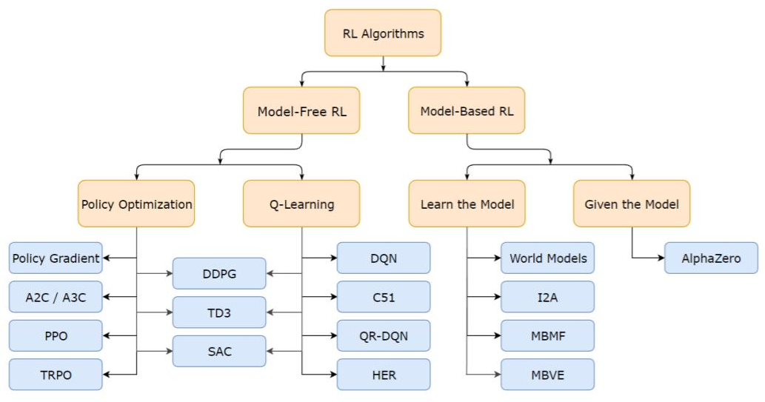
Brief Taxonomy of RL Methods

Slide 28
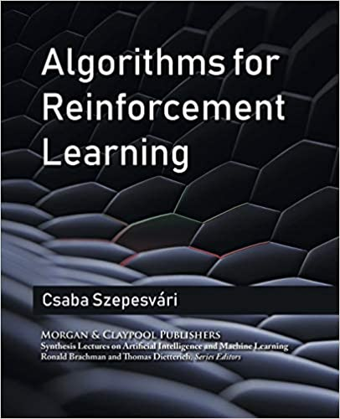

Resources used
Sutton, R. S., & Barto, A. G. (2015). Reinforcement learning: An introduction. MIT press. http://richsutton.com
Csaba Szepesvári (2010). Algorithms for reinforcement learning Morgan and Claypool. https://sites.ualberta.ca/~szepesva/rlbook.html
Lectures at UCL from DeepMind Research Scientists:
David Silver, 2015, https://www.davidsilver.uk/wp-content/uploads/2020/03/MC-TD.pdf
Hado Van Hansselt, 2018 https://www.youtube.com/watch?v=nnxHlg-2WgA&list=PLqYmG7hTraZBKeNJ-JE_eyJHZ7XgBoAyb&index=4
https://www.deepmind.com/learning-resources/reinforcement-learning-lecture-series-2021
Notes:
https://www.microsoft.com/en-us/research/blog/exploring-the-fundamentals-of-multi-armed-bandits/

Slide 29
Basic concepts - Structure
Agent: external to the environment, take actions and has access to external states
Environment: constrains the agent, has hidden and visible states
State: visible information about the environment after an action was taken
Reward: value obtained after taking an action or being at a state
Action: taken by an agent, might cause a change in state
Goal: Maximize rewards by using an optimal policy
Policy: set of state action pairs
Markov property: we only need to know the current state to predict the next state

Slide 30
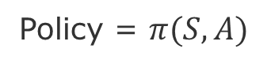
Agent and Environment Interaction
Action
Agent
Environment
State
Reward
Agent’s Goal: Maximize its reward
Our Goal: Discover a strategy that allows the agent to achieve its goal under various circumstances
Search, Estimate, Learn
Policy = $π(S,A)$
knowlege about the environment

Slide 31
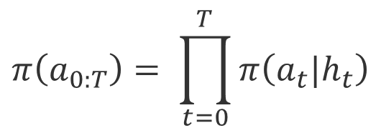
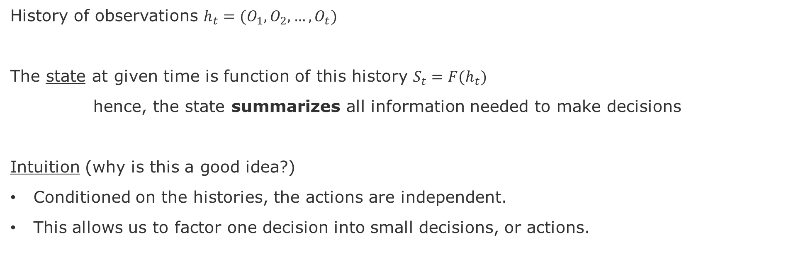
State
History of observations $h_{t}=(O_{1},O_{2}, …,O_{t})$
The state at given time is function of this history $S_{t}=F(h_{t})$
hence, the state summarizes all information needed to make decisions
Intuition (why is this a good idea?)
Conditioned on the histories, the actions are independent.
This allows us to factor one decision into small decisions, or actions.
$$π\left(a_{0:T}\right)= \prod_{t=0}^{T}{π\left(a_{t}|h_{t}\right)}$$

Slide 32
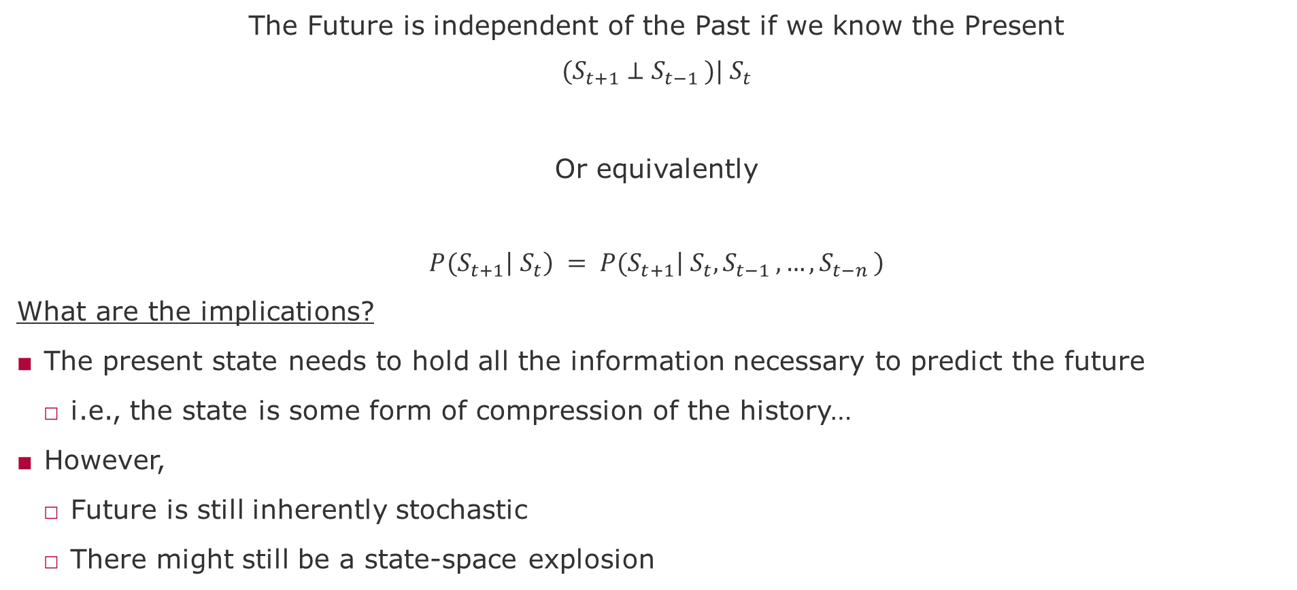
Markov Property
The Future is independent of the Past if we know the Present
$${(S}_{t+1} ⊥S_{t−1 })|{ S}_{t}$$
Or equivalently
$${P(S}_{t+1}\left|{ S}_{t}\right) = {P(S}_{t+1}\left|{ S}_{t},S_{t−1 },…,S_{t−n }\right)$$
What are the implications?
The present state needs to hold all the information necessary to predict the future
i.e., the state is some form of compression of the history…
However,
Future is still inherently stochastic
There might still be a state-space explosion
The History does not make any difference

Slide 33
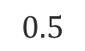
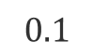
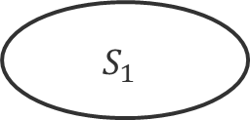
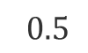
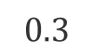
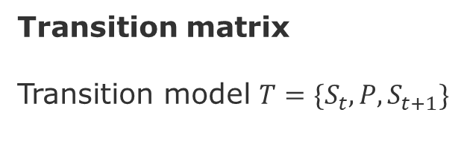
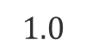
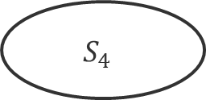
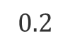

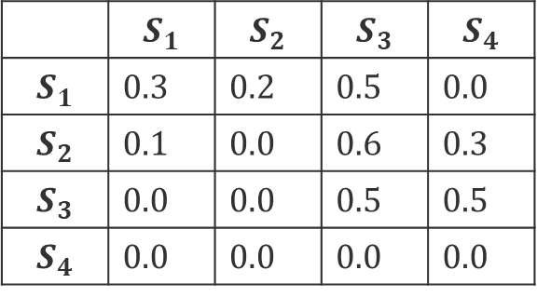
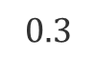

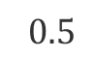
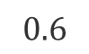
Markov Chain
MDP = Markov Chain + Actions
Transition matrix
Transition model ${T=\{S}_{t},P,S_{t+1}\}$
$$0.3$$
$$0.5$$
$$S_{1}$$
$$0.5$$
$$S_{3}$$
 | $$S_{1}$$ | $$S_{2}$$ | $$S_{3}$$ | $$S_{4}$$
$$S_{1}$$ | 0.3 | 0.2 | 0.5 | 0.0
$$S_{2}$$ | 0.1 | 0.0 | 0.6 | 0.3
$$S_{3}$$ | 0.0 | 0.0 | 0.5 | 0.5
$$S_{4}$$ | 0.0 | 0.0 | 0.0 | 0.0
$$0.2$$
$$0.1$$
$$0.6$$
$$0.5$$
$$S_{2}$$
$$0.3$$
$$S_{4}$$
$$1.0$$
End
Problems of learning and planning
Problems of prediction and control

Slide 34
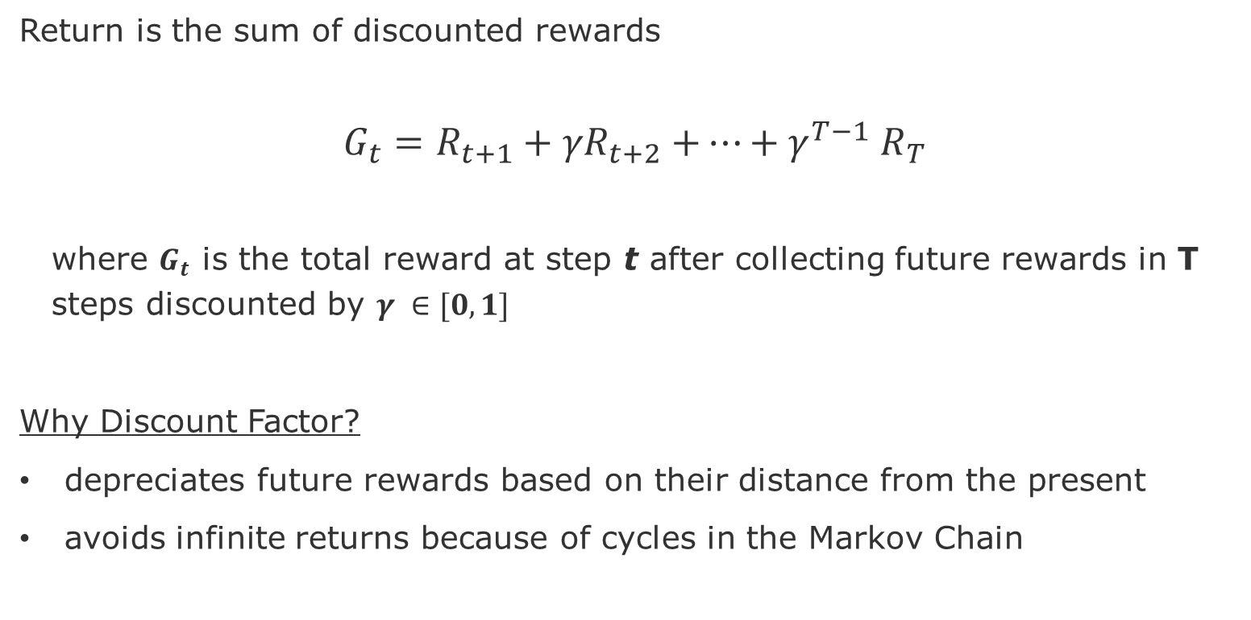

Return ($G$) and Discount Factor ($γ)$
Return is the sum of discounted rewards
$$G_{t}=R_{t+1}+{γR}_{t+2}{+…+γ}^{T−1}R_{T}$$
where $G_{t}$ is the total reward at step t after collecting future rewards in T steps discounted by $γ ∈[0,1]$
Why Discount Factor?
depreciates future rewards based on their distance from the present
avoids infinite returns because of cycles in the Markov Chain

Slide 35
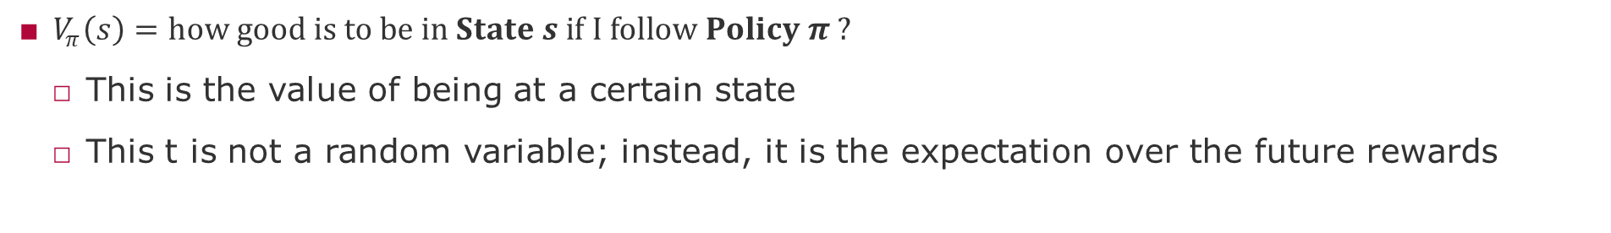
State Value Function
$V_{π}\left(s\right)=how good is to be in State s if I follow Policy π ?$
This is the value of being at a certain state
This t is not a random variable; instead, it is the expectation over the future rewards

Slide 36
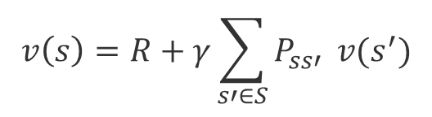
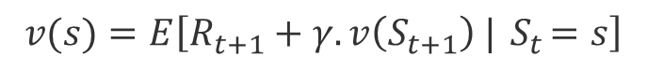
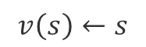
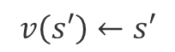
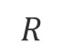
Bellman Equation
The value of being in a certain state is an average of:
The reward of leaving the state t
Value of being at a next state t+1
$$v(s)=E\left[R_{t+1}+γ.v\left(S_{t+1}\right) |{ S}_{t}=s\right]$$
$$v\left(s\right)←s$$
$$R$$
$$v\left(s′\right)←s′$$
One-Step Lookahead idea
$$v\left(s\right)=R+γ\sum_{s′∈S}{P_{ss′}} v(s^{′})$$

Slide 37
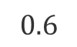
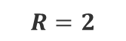
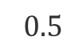
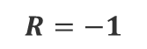







































Markov Reward Process (MRP)
$$0.3$$
$$R=−2$$
$$0.5$$
$$R=−2$$
$$0.3$$
$$R=−2$$
$$0.5$$
$$R=−2$$
$$S_{1}$$
$$0.5$$
$$S_{3}$$
$$S_{1}$$
$$0.5$$
0
$$R=−1$$
$$R=−1$$
$$0.2$$
$$0.1$$
$$0.6$$
$$0.5$$
$$R=4$$
$$0.2$$
$$0.1$$
$$0.6$$
$$0.5$$
$$R=4$$
$$R=−1$$
$$R=−1$$
$$R=1$$
$$R=−1$$
$$R=1$$
$$R=−1$$
$$S_{2}$$
$$0.3$$
$$S_{4}$$
$$1.0$$
$$S_{2}$$
$$0.3$$
20
$$1.0$$
End
End
$$R=2$$
$$R=2$$
$$R=0$$
$$R=0$$
Assuming $γ$=1
Initialize value states with zero
Value of $S_{3}$ = 4 + 20*0.5 +(-2 +0.5*0.0) =14

Slide 38



Bellman equation in matrix form
$$v=R+γPv$$
$$\left[\begin{matrix}v(1) \\ ⋮ \\ v(n)\end{matrix}\right]=\left[\begin{matrix}R_{1} \\ ⋮ \\ R_{n}\end{matrix}\right]+ γ\left[\begin{matrix}P_{11} & ⋯ & P_{1n} \\ ⋮ & ⋯ & ⋮ \\ P_{n1} & ⋯ & P_{nn}\end{matrix}\right]\left[\begin{matrix}v(1) \\ ⋮ \\ v(n)\end{matrix}\right]$$
$$v=(1− γPv)^{−1} R$$
Feasible for small number of states
Linear version of the Bellman Equation

Slide 39

Markov Decision Process (MDP)
MDP = Markov Chain + Actions
Actions allow us to have control over the decision-making process
Policy = distribution over actions given states $π\left(s,a\right)=P(A_{t}=a|$ $S_{t}=s)$
Implications to the model:
Transition for each action
Results of actions can be stochastic (non-deterministic)
Action Value Function
$$Q_{π}\left(s,a\right)=how good is to be in State s and to take Action a if I follow Policy π ?$$
i.e., $Q_{π}\left(s,a\right)$ is the expected return of being at a state and taking a certain action and following a certain policy

Slide 40
Bellman Optimatility Equation
How to find the best path in the MDP?
Bellman equation estimates V(s) by looking ahead of possible future trajectories in the state-space
Intuition
If we behave optimally for the first step and then also behave optimally for the next step, we will find the optimal solution for the MDP. However, note that to behave optimally I need to average over all possible paths that are opened by my first step.

Slide 41













Bellman Optimality Equations for MDPs
$$v^{∗}\left(s\right)←s$$
$$v^{∗}\left(s\right)←s$$
$$R$$
$$q\left(s,a\right)←s,a$$
$$R$$
$$q^{∗}\left(s,a\right)←s,a$$
$$R$$
$$q^{∗}\left(s,a\right)←s,a$$
$$v^{∗}\left(s′\right)←s′$$
$$v^{∗}\left(s′\right)←s′$$
$$q^{∗}\left(s,a\right)=R_{s}^{a}+γ\sum_{s′∈S}{P_{ss′}^{a}}v^{∗}\left(s′\right)$$
$$v^{∗}\left(s\right)=\max_{a}{q^{∗}\left(s,a\right)}$$
$$v^{∗}\left(s\right)=\max_{a}\left({ R}_{s}^{a}+γ\sum_{s′∈S}{P_{ss′}^{a}}v^{∗}\left(s′\right)\right)$$
The value function of a state is the maximum that I can get after taking an action
The optimal value is the expected return of the multiple states that we can end up after taking action a

Slide 42















Episodes
$$A_{1.1}$$
$$A_{3.3}$$
Episode | Transitions | Σ Reward
1 | $$\left\{S_{1},A_{1.3},S_{3}\right\},\left\{S_{3},A_{3.3},S_{3}\right\}\left\{S_{3},A_{3.4},S_{4}\right\}$$ | 90
2 | $$\left\{S_{1},A_{1.2},S_{2}\right\},\left\{S_{2},A_{2.3},S_{3}\right\}\left\{S_{3},A_{3.4},S_{4}\right\}$$ | 110
3 | $$\left\{S_{1},A_{1.2},S_{2}\right\},\left\{S_{2},A_{2.3},S_{4}\right\}$$ | 60
4 | $$\left\{S_{2},A_{2.1},S_{1}\right\},\left\{S_{1},A_{1.3},S_{3}\right\}\left\{S_{3},A_{3.4},S_{4}\right\}$$ | 120
5 | $$\left\{S_{3},A_{3.3},S_{3}\right\}\left\{S_{3},A_{3.4},S_{4}\right\}$$ | 40
6 | $$\left\{S_{2},A_{2.3},S_{3}\right\},\left\{S_{3},A_{3.3},S_{3}\right\}\left\{S_{3},A_{3.4},S_{4}\right\}$$ | 80
7 | $$\left\{S_{2},A_{2.4},S_{4}\right\}$$ | 40
$$S_{1}$$
$$A_{1.3}$$
$$S_{3}$$
$$0.6$$
$$A_{1.2}$$
$$A_{2.1}$$
$$A_{3.4}$$
$$A_{2.3}$$
$$0.4$$
$$S_{2}$$
$$S_{4}$$
What can we infer from these episodes?
We can infer the ${R(\{S}_{1},A_{1.2},S_{2}\}$) = 60
We do not need to know all transitions
But we are not 100% sure because transitions are not deterministic

Slide 43
Model-Based Algorithms
Notes:
https://en.wikipedia.org/wiki/Transduction_(machine_learning)

Slide 44

Prediction versus Control Problems
Prediction
Goal: How much reward I am going to obtain from this MDP?
Input: An MDP (S, A, P, R, γ) and Policy ϖ
Output: Value Function $V_{π}\left(s\right)$
Control
Goal: Among all possible policies, what is the best policy for this MDP?
Input: An MDP (S, A, P, R, γ)
Output: an optimal Value Function $V_{π}^{∗}\left(s\right)$, which corresponds to an optimal policy ϖ*
Control
For-loop:
Prediction

Slide 45









Policy Evaluation and Policy Iteration
$$v_{k+1}\left(s\right)←s$$
$$a$$
$$R$$
$$v\left(s′\right)←s′$$
One step lookahead
$$v_{k+1}\left(s\right)=\sum_{a ∈A}{π\left(a | s\right)\left(R_{s}^{a}+γ\sum_{s′∈S}{P_{ss′}^{a}}v(s^{′})\right)}$$
current Reward
discounted future Reward
Evaluate:
$$v^{k+1}(s)=R^{π}+γP^{π}v^{k}$$
Improve:
$$π^{′}\left(s\right)=\max_{a ∈A}{q_{π}(s,a)}$$
Greedy!
Source: Silver, 2015, https://www.davidsilver.uk/wp-content/uploads/2020/03/DP.pdf

Slide 46









Value Iteration
$$v_{k+1}\left(s\right)←s$$
Algorithm:
For 1+k iteration:
For all states in S:
Update $v^{k+1}\left(s\right)$ from $v^{k}$(s)
$$a$$
$$R$$
$$v\left(s′\right)←s′$$
$$v_{k+1}\left(s\right)=\max_{a ∈A}\left(R_{s}^{a}+γ\sum_{s′∈S}{P_{ss′}^{a}}v(s^{′})\right)$$
$$v^{k+1}\left(s\right)=\max_{a ∈A}\left(R^{a}+γP^{a}v^{k}\right)$$
Source: Silver, 2015, https://www.davidsilver.uk/wp-content/uploads/2020/03/DP.pdf

Slide 47
Model-Free Methods
Notes:
https://en.wikipedia.org/wiki/Transduction_(machine_learning)

Slide 48

Monte Carlo Policy Evaluation
Sample the rewards for each action across multiple Episodes
Similar to what we have seen in the Multi-Armed Bandits
Discounted Rewards for an episode ending at time T>t
$$G_{t}=R_{t+1}+γR_{t+2}+{γ_{ }^{2}R}_{t+3}+…+{γ_{ }^{T−t−1}R}_{T}$$
Value function is the Expected Return
$$V_{π}=E{[G}_{t} | S_{t}=s,π]$$
Caveat: Multiple episodes necessary to update the state value function under a policy $V_{π}\left(S\right)$

Slide 49

Incremental Mean
Source: Silver, 2015, https://www.davidsilver.uk/wp-content/uploads/2020/03/MC-TD.pdf

Slide 50


Incremental Monte Carlo Updates
Updates $V_{π}\left(S\right)$ after each episode
Increments visits $N\left(S_{t}\right)++$
Update $V_{π}\left(S\right)= V_{π}\left(S\right)+\frac{1}{N\left(S_{t}\right)}(G_{t} −V_{π}\left(S\right))$
We are essentially tracking a running average, in other words, we are forgetting older episodes. Rate of forgetting can be further parameterized with a learning factor alpha
$$V_{π}\left(S\right)= V_{π}\left(S\right)+α(G_{t} −V_{π}\left(S\right))$$
Advantages:
Non-stationary estimator
Memoryless algorithms
Caveats:
Requires complete episodes must terminate (reach terminal state)
High variance, low bias (because $G_{t}$ is an unbiased estimate of future rewards)

Slide 51



Temporal Difference Learning
Recalling Policy Iteration
$$v^{t+1}\left(s\right)=R^{π}+γP^{π}v^{t}$$
$$v_{t+1}\left(S_{t}\right)=E{[R}_{t+1 }+γv_{t}\left(S_{t+1}\right)| S_{t}=s,A_{t \sim }π{(s}_{t})]$$
Bootstrapping
Monte Carlo
TD Learning
TD-Error
Advantages:
Updates with partial episodes
Size of partial episode is parameterizable (lambda)
Caveat: High Bias, but less variance (because update depends on only one action)

Slide 52

Batch Learning = Limited Budget
The batch dataset has 8 episodes with the following (state, return) values
Episode | Data
1 | (A,0), (B,0)
2 | (B,1)
3 | (B,1)
4 | (B,1)
5 | (B,1)
6 | (B,1)
7 | (B,1)
8 | (B,0)
What are the value function estimates for A and B?
Monte Carlo:
(A) = 0/8 = 0,
V(B) = 6/8 = 0.75
Temporal Difference:
V(A) = R(A) + [R(B) + V(B) - V(A)] = 0.75
V(B) = 0.75

Slide 53


Temporal Difference (TD) vs Monte Carlo (MC)
source: page 125 [Sutton & Barto 2018]
Notes:
Left plot: TD learning approximate true value of the states (black line) after 100 steps.
Right plot:
RMSE – Root mean-squared error between the value function learned and the true value
function, averaged over the five states, then averaged over 100 runs.
Low step size in makes TD and MC error curves smoother, however it takes longer to drop. Both converge to the trur value, but MC is noisier (higher variance).
Larger step size makes TD approximate faster, but it stabilizes at a higher error level.

Slide 54

Summary of pros and cons
Monte Carlo
High Variance, Low Bias
Good Convergence properties (even with function approximation)
Not very sensitive to initial values
Simple to understand and use
More efficient in non-Markov environments, because it does not explore the Markov Property
TD
Low Variance, High Bias
TD(zero) converges to $v_{π}(s)$(not always with function approximation)
More sensitive to initial values
More efficient in Markov environments, because it does explore the Markov Property

Slide 55




Comparing the three models
Monte Carlo
Temporal Difference
Bootstrapping: updating = to estimate
MC does not bootstrap
DP and TD bootstrap
Sampling: updating = to sample an expectation
MC and TD sample
DP does not sample
Dynamic programming

Slide 56


Trade-off between TD(0) and MC = TD(lambda)
Which n-value is the best?
Alpha = Learning rate
Gamma = Discount rate

Slide 57

TD(λ) Which n value is the best?

Slide 58
Control Improving the policy to find optimal value-function
Notes:
https://en.wikipedia.org/wiki/Transduction_(machine_learning)

Slide 59


Generalized Policy Iteration
Convergence
ϖ* ==V*
Policy Evaluation:
What? estimates V^{ϖ}
How? Iterative policy evaluation
Policy Improvement:
What? generates a ϖ’ ≥ ϖ
How? Greedy policy improvement
Variations to these components:
Monte Carlo Evaluation
epsilon-Greedy (fixed exploration rate)
Monte Carlo GLIE (decaying exploratoin rate)
TD(0) and TD(lambda)
Notes:
We will vary these two components.

Slide 60



Monte Carlo Control
V(s) = how good a state s is (expected total reward starting from s following the policy).
Solution part-1: use Q because it is based on state, action pairs
$$v^{k+1}\left(s\right)=\max_{a ∈A}\left(R^{a}+γP^{a}v^{k}\right)$$
Q(s, a) = how good it is to take action a in state s (expected total reward if you do a, then follow the policy)
No guarantee that will find the optimum
Control
for-loop:
Solution part-2: add randomness in the choice of action (e-Greedy)
Prediction
Notes:
🧩 1. The Goal in Reinforcement Learning
In reinforcement learning (RL), the agent wants to learn how to act in order to get the most total reward in the long run.
It does this by learning a policy — a mapping from states (situations) to actions (what to do). The “best” policy is the one that maximizes expected cumulative reward — that’s what we mean by the optimal policy.
To reach that goal, the agent usually needs to estimate something called a value function:
V(s) = how good a state s is (expected total reward starting from s following the policy).
Q(s, a) = how good it is to take action a in state s (expected total reward if you do a, then follow the policy).
🧠 2. Iterative Policy Evaluation (Monte Carlo style)
Monte Carlo (MC) methods are one way to estimate the value function.
You let the agent follow a policy many times, collect full episodes of experience (state → action → reward → next state → ...), and average the returns to estimate how good each state (or state-action pair) is.
For example:
If every time you start in state A and follow the policy you get about +5 total reward on average, then V(A) ≈ 5.
That’s policy evaluation — learning what happens if you follow the current policy.
⚠️ 3. The Problem: You might never find the optimal policy
Monte Carlo methods by themselves just evaluate whatever policy you’re currently using — they don’t improve it unless you explicitly change it.
If your policy is bad (say, it never tries new actions), you might never discover better actions. So even though your value estimates (V) get more accurate for the current policy, the policy itself stays stuck — and therefore you may never find the optimal value function or the optimal policy.
🛠️ 4. First Fix: Use Q-values instead of V-values
If you only use V(s), you know how good a state is — but not which action inside that state led to it. So you can’t easily decide which actions to change.
If you use Q(s, a), now you know:
“If I’m in state s, how good is each possible action a?”
This lets you compare actions directly and choose the best one — that’s called policy improvement.
So Q-learning and similar methods use Q-values to update the policy toward better actions.
🎲 5. Second Fix: Add Randomness (ε-Greedy)
Even with Q-values, you can still get stuck: If you always choose the action with the highest Q(s, a) (a greedy policy), you might never explore new actions that could actually be better.
So we add a bit of randomness:
With probability ε, choose a random action (explore).
With probability 1−ε, choose the best known action (exploit).
This is called ε-greedy exploration. It ensures that you keep trying new things occasionally, which allows you to improve your estimates of Q(s, a) and move closer to the optimal policy.
🧭 6. Putting it all together
Step Concept Purpose 1 Iterative Policy Evaluation (MC) Estimate how good a policy is based on experience 2 Switch from V(s) to Q(s, a) Learn which actions are good, not just which states 3 ε-Greedy Exploration Avoid getting stuck — keep exploring so you can find better actions Together, these ideas form the foundation for control in reinforcement learning — improving a policy until it becomes optimal.
🌟 Intuitive Analogy
Imagine you’re trying to find the best restaurant in a new city:
Policy evaluation (V): You always go to the same place and rate how much you like it. You know how good that choice is, but not others.
Q-learning (Q): You track how much you like each restaurant (state-action pair). Now you can compare and choose.
ε-greedy: Even if you have a favorite, sometimes you try a random new place — maybe it’s even better.
Over time, this balance between learning what works and exploring what might work better lets you discover the optimal restaurant — or, in RL terms, the optimal policy.
Would you like me to also show a small diagram or pseudocode (with intuition) of how ε-greedy Q-learning updates the policy? It can make the concept click even more clearly.

Slide 61

GLIE Monte Carlo Control
GLIE – Greedy in the Limit with Infinite in the limit Exploration
Decays epsilon, for instance ε
$ε=\frac{1}{k}$, where k is the episode count
All <state,action> pairs are explored indefinitely
$$\lim_{k→∞}N_{k}\left(s,a\right)= ∞$$
The policy ϖ converges to a greedy policy
$$\lim_{k→∞}{π_{k}\left(s,a\right)=I(a= \max_{a′}{q_{k}(s,a′)})}$$
Theorem shows that it also converges to the optimal value-function
$$\lim_{k→∞}{π_{k}\left(s,a\right)=I(a= \max_{a′}{q_{k}(s,a′)})}$$
Advantage: Converges to the optimal greedy policy
Caveat: Still expensive, even with partial episodes

Slide 62

On-Policy versus Off-Policy Control
On-Policy
Learn on the job
How? Learn about policy $π$ from experience sampled from $π$
Off-Policy
Look over someone else’s shoulder
How? Learn about policy $π$ from experience sampled from the environment

Slide 63





Sarsa: On-Policy TD Control
Advantage: Converges to the optimal greedy policy
Caveat: Still expensive, even with partial episodes

Slide 64

Q-Learning: off-policy TD Control
Choose among all possible actions

Slide 65
Comparing Sarsa and Q-Learning
Q-Learning does not follow any given policy to update the Q-value
However, Q-Learning still follows a “behavioral” policy in order to determine which state-action pairs to visit

Slide 66

Trade-off between Sarsa and Q-Learning
Gridworld example from [Sutton & Barto 2018] page 132.
Goal: is to go from S to G avoiding the Cliff.

Slide 67


N-Step Sarsa TD(λ)

Slide 68
More Recent Methods
DQN
Policy Gradient
A2C, A3C
PPO
TRPO
DDPG
SAC

Slide 69
Model-Based Methods Dyna-Q: learning a model of the environment

Slide 70
Dyna-Q: learning a model of the environment
“Thinking is acting in an imagined space” (Konrad Lorenz)
“Perception is a generative act” – Gross et al. [1999]
“Consciousness is a controlled hallucination” - Anil Seth [2000]
“The images that reach consciousness hold little resemblance with reality” - Lucia Meloni
“The world as we perceive it is our own invention “- Heinz von Furster
Notes:
[Gross et al. 1999] H.-M. Gross, A. Heinze, T. Seiler, V. Stephan, Generative character of perception: a neural architecture for sensorimotor anticipation, Neural Networks, Volume 12, Issues 7–8, 1999, Pages 1101-1129, ISSN 0893-6080,
https://doi.org/10.1016/S0893-6080(99)00047-7.

Slide 71
Motivation
Algorithms are built with the assumption that we can obtain the true model of the environment.
This might not be true in many situations:
data is non-i.i.d. (independent and identically distributed) data (autocorrelations)
environment is non-stationary (change in distributions)
multiple agents interact within the environment (interference)

Slide 72
Model-Based RL
Advantages:
Domains where learning a value function is hard, e.g., domains with large action space, like chess. The model is straightforward (2 x 2 table with deterministic outcomes of actions)
In these cases, a model is a more compact and more useful representation than a value-function or a policy
Can efficiently learn a model using supervised learning
Can reason about model uncertain
Allows the agent to look ahead. To make decisions based on what the agent believes about how the environment works.
Disadvantage - Two sources of approximation error:
learning the model then
constructing a value function

Slide 73
Intuition-1
What is the difference between learning a reward function vs a value function (as we did in q-learning)?
Difficult scenarios for learning a value function:
Board games with an explosion of possible moves and configurations
Maze that changes after each episode
Solution:
learn a model of the environment
use that to learn the value function
Learning a model = learning the transition probabilities

Slide 74
Intuition-2
Models of the environment:
allow to retrieve state and actions that are useful.
avoid costly interaction with the environment
Conversely:
Without a model, the experience that we learn is too tightly coupled with the data
Models allow to keep a level of skepticism about this experience
Example:
Sometimes we are in an area where I know nothing, so learning is very hard.
Other times, we are in an area where I know everything, so I have to go far to learn something new.

Slide 75

What is a model that we can learn?
A model is a representation of the MDP <s, a, ρ_{η}> s=states, a=actions, ρ=transitions parameterized by η
Assuming that states and actions are the same as in the environment
Learn the transition function and the reward

Slide 76


How do we learn a model from experience?
Given a stream of experiences: {S₁,A₁, R₂, … S_{T}}
It is a supervised learning problem
Learn a function that:
f(s,a) = r, s’
Example:
choose a loss function (mean-squared error)
find the parameter η for the transition function ρ_{η} that minimizes the empirical loss
Expectation model

Slide 77



Expectation Model
Considering Linear Model
Transition matrix P
Value function V
Expectation move to inside
Caveat: Might provide states that are never achievable, which happens in non-linear models

Slide 78

Stochastic Model (Generative Models)
Instead of querying the real environment, we query our stochastic model.
Allows to sample trajectories that are plausible, in contrast with expected states.
We add a noise term ω
Caveat: Stochastic models increase variance because of the noise

Slide 79

Full Models (Generative Models)
Balance bias and variance by learning the transitions and the stochasticity of the environment.
This involves branching for every state for the same action:
“For continuous state spaces, these sums will become integrals. “
Caveat: These trees also might grow very fast.

Slide 80
How to represent these learned models?
Table lookup Model
Linear Expectation Model
Linear Gaussian Model
Deep Neural Network Model

Slide 81


Table Lookup Model
It is an explicit MDP
It counts the visits N(s,a) to each state action pair
Transition function
Reward function

Slide 82

Inaccurate models
Given an imperfect model where
Performance will be limited to the optimal policy for an approximate MDP <s, a, ρ_{η}>
Hence Model-Based RL will be only as good as the estimated model
Alternative solutions:
When model is wrong, use Model-Free RL
Reason explicitly about the model uncertainty over η (e.g., Bayesian methods)
Combine model-based and model-free in a safe way

Slide 83


Real versus Simulated Experiences
Real experience is sampled from the environment (true MDP)
Simulated experience is sampled from our model (approximate MDP)

Slide 84
Road so far
Model-Free RL
No Model
Learn Value function of Policy from Experience
Model-Based RL
Learn a model from the experience or be given a Model (simulated experience)
Plan Value function or Policy from Model
Dyna Architecture
Learn a Model from the experience
Learn and Plan Value function or Policy from Real and the Model
Treat Real and simulated experiences equivalently
Updates from learning and planning are not distinguished
Notes:
When an agent has a model of the environment, the border between the agent and the environment becomes more difficult to determine.

Slide 85



Dyna Architecture
?
?
New observation from the environment
OR
Reuse previous observations (experience replay)
?
Notes:
Local decisions per shop, Global decisions across shops
Failure propagation as a sub-model of the transitions
Check the impact of failures on same component type happening in different shops.
Clarify what the model is with respect to the decision model and the state model
Difference frequencies of execution of each loop. How to determine when to execute each loop?
Lowe level loop abstracts the environment.
Not every monitoring is an experience that we can use for learning.
Features are graph queries, hence feature discovery map to evaluating graph queries.
Examples of how these architectures would look like.
Utility change prediction (which we did in the past) could be done in an online context.

Slide 86

Dyna pseudo-code
Python code example: https://github.com/andrecianflone/dynaq/blob/master/dynaq.py

Slide 87

Dyna Q with a Maze example

Slide 88

Dyna-Q with inaccurate model
Model changed! Became harder to attain the goal
Dyna-Q+ is Dyna-Q with an exploration bonus that encourages exploration
Dyna-AC is a Dyna-Q that uses an actor-critic learning method instead of Q-learning

Slide 89

Dyna-Q with easier inaccurate model
Model changed! Became easier to attain the goal

Slide 90
Next tasks
Watch DeepMind intro lecture to consolidate your knowledge (https://www.deepmind.com/learning-resources/reinforcement-learning-lecture-series-2021)
Select a RL Survey of your choice (Check Zotero)
Prepare to comment on your readings for next class (5-10 min)

Slide 91
Interesting video lectures on RL
David Silver, 2015, University College London Lecture 1 https://www.youtube.com/watch?v=2pWv7GOvuf0 Course website: https://www.davidsilver.uk/teaching/ | Bottom-up explanations based on the math and introducing the simpler models before adding the complexity.
DeepMind series of Lectures https://www.deepmind.com/learning-resources/reinforcement-learning-lecture-series-2021 | Follows a similar format of David Silver’s lectures 2015.
Short 6 Lectures von Peter Abeel https://www.youtube.com/playlist?list=PLwRJQ4m4UJjNymuBM9RdmB3Z9N5-0IlY0 | Basics + Advanced methods like PPO, TRPO, DDPG.
Pascal Poupert, 2018, University of Waterloo, Canada Lecture 1b: https://www.youtube.com/watch?v=yOWBb0mqENw&list=PLdAoL1zKcqTXFJniO3Tqqn6xMBBL07EDc&index=2&pbjreload=10 Course website: https://cs.uwaterloo.ca/~ppoupart/teaching/cs885-spring20/schedule.html | More conceptual level with examples of applications.
Charles Isbell & Michael Littman, 2015, Georgia Tech https://www.youtube.com/watch?v=rETmf4NnlPM&list=PL__ycckD1ec_yNMjDl-Lq4-1ZqHcXqgm7&index=128&pbjreload=10 | Step-by-step explanations with fun discussions and lot of small examples to illustrate each core MDP principle
Nando Freitas, 2015, Lectures Oxford University, UK Lecture 15 https://www.youtube.com/watch?v=kUiR0RLmGCo Lecture 16 https://www.youtube.com/watch?v=dV80NAlEins Course Website: https://www.cs.ox.ac.uk/people/nando.defreitas/machinelearning/ | Lectures in the context of Deep Learning, but still provide the necessary concepts of RL.
2
1

Slide 92
To be continued in the next lecture

Slide 93
End

Slide 94
Incremental implementations
Budget
Infinite
Finite
Model-Based
Model-Free
Finite
State Space
Model-Free or
Approximate
Approximate
Infinite

